Slide 1
Factors: How Time and Interest Affect Money

Slide 2
LEARNING OUTCOMES
F/P and P/F Factors
P/A and A/P Factors
F/A and A/F Factors
Factor Values
Arithmetic Gradient
Geometric Gradient
Find i or n

Slide 3
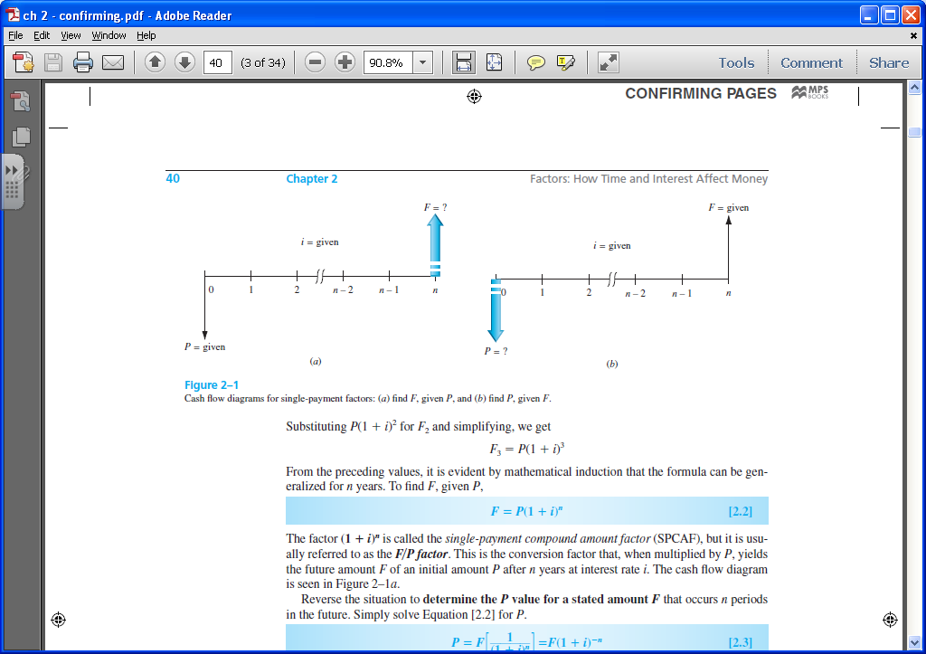
Single Payment Factors (F/P and P/F)
Single payment factors involve only P and F. Cash flow diagrams are as follows:
Formulas are as follows:
F = P(1 + i ) ^{n}
P = F[1 / (1 + i ) ^{n}]
Terms in parentheses or brackets are called factors. Values are in tables for i and n values
Factors are represented in standard factor notation such as (F/P,i,n),
where letter to left of slash is what is sought; letter to right represents what is given

Slide 4
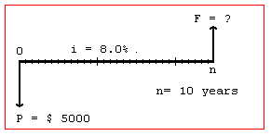
Example: Finding Future Value
A person deposits $5000 into an account which pays interest at a rate of 8% per year. The amount in the account after 10 years is closest to:
(A) $2,792 (B) $9,000 (C) $10,795 (D) $12,165
The cash flow diagram is:
Solution:
F = P(F/P,i,n )
Answer is ?

Slide 5
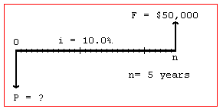
Example: Finding Present Value
A small company wants to make a single deposit now so it will have enough money to
purchase a backhoe costing $50,000 five years from now. If the account will earn
interest of 10% per year, the amount that must be deposited now is nearest to:
(A) $10,000 (B) $ 31,050 (C) $ 33,250 (D) $319,160
Solution:
The cash flow diagram is:
P = F(P/F,i,n )
Answer is ?

Slide 6
Uniform Series Involving P/A and A/P
The uniform series factors that involve P and A are derived as follows:
(1) Cash flow occurs in consecutive interest periods
(2) Cash flow amount is same in each interest period
The cash flow diagrams are:
A = Given
A = ?
0
1
2
3
4
5
0
1
2
3
4
5
P = ?
P = Given
P = A(P/A,i,n)
A = P(A/P,i,n)
Standard Factor Notation
Note: P is one period Ahead of first A value

Slide 7
Example: Uniform Series Involving P/A
A chemical engineer believes that by modifying the structure of a certain water
treatment polymer, his company would earn an extra $5000 per year. At an interest
rate of 10% per year, how much could the company afford to spend now to just
break even over a 5 year project period?
(A) $11,170 (B) 13,640 (C) $15,300 (D) $18,950
Solution:
The cash flow diagram is as follows:
A = $5000
P = 5000(P/A,10%,5)
0
1
2
3
4
5
P = ?
i =10%
Answer is ?

Slide 8
Uniform Series Involving F/A and A/F
The uniform series factors that involve F and A are derived as follows:
(1) Cash flow occurs in consecutive interest periods
(2) Last cash flow occurs in same period as F
Cash flow diagrams are:
A = ?
A = Given
0
1
2
3
4
5
0
1
2
3
4
5
F = ?
F = Given
F = A(F/A,i,n)
Standard Factor Notation
A = F(A/F,i,n)
Note: F takes place in the same period as last A

Slide 9
Example: Uniform Series Involving F/A
An industrial engineer made a modification to a chip manufacturing process that will save her company $10,000 per year. At an interest rate of 8% per year, how much will the savings amount to in 7 years?
(A) $45,300 (B) $68,500 (C) $89,228 (D) $151,500
The cash flow diagram is:
F = ?
Solution:
F = 10,000(F/A,8%,7)
i = 8%
0 1 2 3 4 5 6 7
A = $10,000

Slide 10
Arithmetic Gradients
Arithmetic gradients change by the same amount each period
The cash flow diagram for the P_{G}
of an arithmetic gradient is:
G starts between periods 1 and 2
(not between 0 and 1)
This is because cash flow in year 1 is usually not equal to G and is handled separately as a base amount
(shown on next slide)
P_{G} = ?
1
2
3
4
n
0
G
2G
3G
Note that P_{G} is located Two Periods Ahead of the first change that is equal to G
(n-1)G
Standard factor notation is
P_{G} = G(P/G,i,n)

Slide 11
Typical Arithmetic Gradient Cash Flow
P_{T} = ?
i = 10%
0 1 2 3 4 5
400
Amount in year 1
is base amount
450
500
550
600
This diagram = this base amount plus this gradient
P_{A} = ?
P_{G} = ?
i = 10%
i = 10%
0 1 2 3 4 5
+
0 1 2 3 4 5
Amount in year 1
is base amount
400
400
400
400
400
50
P_{G} = 50(P/G,10%,5)
100
P_{A} = 400(P/A,10%,5)
150
200
P_{T} = P_{A} + P_{G} = 400(P/A,10%,5) + 50(P/G,10%,5)

Slide 12
Converting Arithmetic Gradient to A
Arithmetic gradient can be converted into equivalent A value using G(A/G,i,n)
i = 10%
i = 10%
0 1 2 3 4 5
0 1 2 3 4 5
G
A = ?
2G
3G
4G
General equation when base amount is involved is
A = base amount + G(A/G,i,n)
For decreasing gradients,
change plus sign to minus
0 1 2 3 4 5
4G
3G
A = base amount - G(A/G,i,n)
2G
G

Slide 13
Example: Arithmetic Gradient
The present worth of $400 in year 1 and amounts increasing by $30 per year through year 5 at an interest rate of 12% per year is closest to:
(A) $1532 (B) $1,634 (C) $1,744 (D) $1,829
Solution:
P_{T} = ?
P_{T} = 400(P/A,12%,5) + 30(P/G,12%,5)
i = 12%
= 400(3.6048) + 30(6.3970)
0
1
2
3
4
5
Year
= $1,633.83
Answer is (B)
400
430
The cash flow could also be converted
into an A value as follows:
460
G = $30
490
520

